Slide 1
Chapter 06_04
Dynamic Programming
Floyd’s Algorithm for Shortest-Paths

Slide 2

Floyd’s Algorithm for the All-Pairs Shortest-Paths Problem
Given a weighted connected graph (undirected or directed), one of several variations of the problem involving shortest paths in graphs:
The all-pairs shortest-paths problem asks to find the distances from each vertex to all other vertices.
(i.e., the lengths of the shortest paths from each vertex to all other vertices.)
Important applications: communications, transportation networks, and operations research.
Among recent applications of all-pairs shortest-path problem: precomputing distances for motion planning in computer games.
We use the distance matrix: the element d_{ij} in the i^{th} row and the j^{th} column to indicate the length of the shortest path from the i^{th} vertex to the j^{th} vertex. Figure 8.14 is an example.

Slide 3
Floyd’s Algorithm
a b c d
a 0 ∞ 3 ∞
W = b 2 0 ∞ ∞
c ∞ 7 0 1
d 6 ∞ ∞ 0
a
2
b
(b) Its weight matrix
3 6 7
a b c d
a 0 10 3 4
T = b 2 0 5 6
c 7 7 0 1
d 6 16 9 0
c
d
1
Digraph
(c) Its distance matrix
Figure 8.14 (a) Digraph. (b) Its weight matrix. (c) Its distance matrix.

Slide 4
Floyd’s Algorithm
Consider Floyd’s algorithm for generating the distance matrix.
The algorithm is applicable to both undirected and directed weighted graphs without containing a cycle of a negative length.
(The distance between any two vertices in such a cycle can be made arbitrarily small by repeating the cycle enough times.)
The algorithm can be enhanced to find not only the lengths of the shortest paths for all vertex pairs but also the shortest paths themselves.

Slide 5
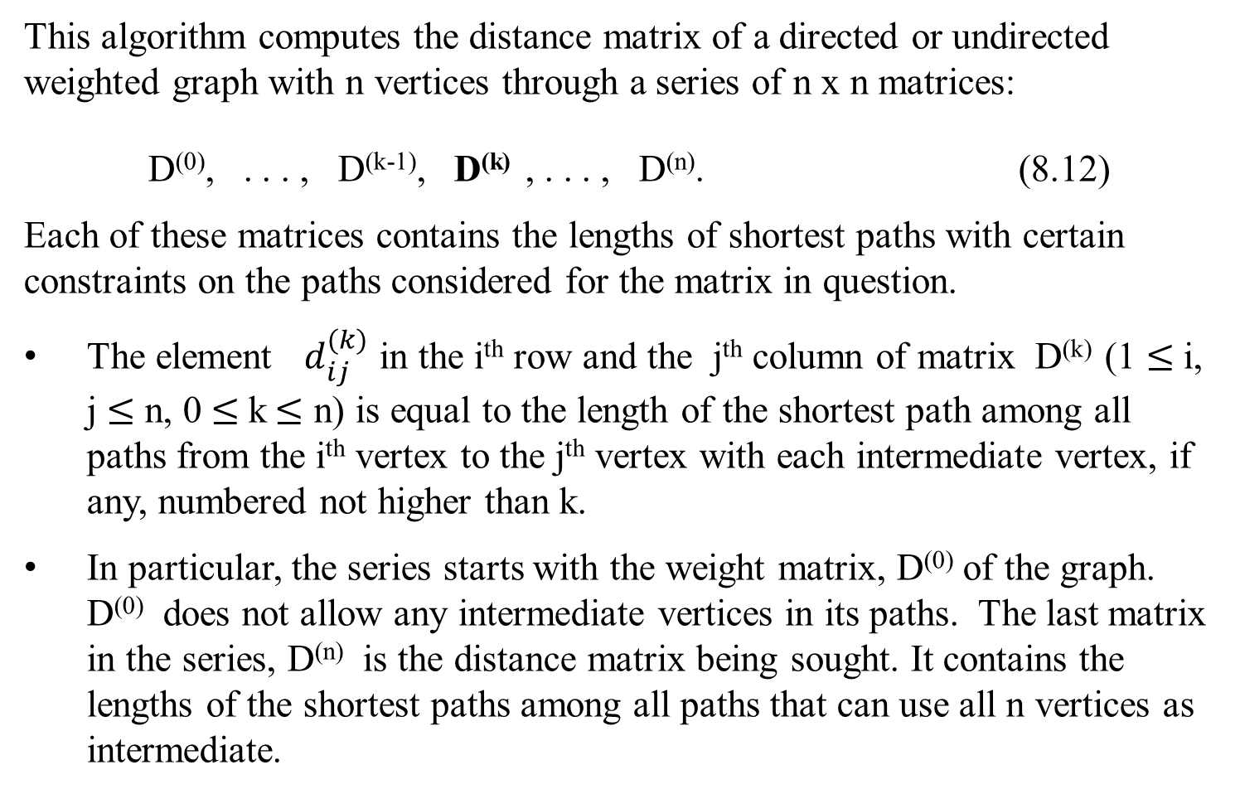
Floyd’s algorithm for generating the distance matrix.
This algorithm computes the distance matrix of a directed or undirected weighted graph with n vertices through a series of n x n matrices:
D⁽⁰⁾, . . . , D^{(k-1)}, D^{(k)} , . . . , D^{(n)}. (8.12)
Each of these matrices contains the lengths of shortest paths with certain constraints on the paths considered for the matrix in question.
The element $d_{ij}^{(k)}$ in the i^{th} row and the j^{th} column of matrix D^{(k)} (1 $≤$i, j $≤$ n, 0 $≤$k$≤$ n) is equal to the length of the shortest path among all paths from the i^{th} vertex to the j^{th} vertex with each intermediate vertex, if any, numbered not higher than k.
In particular, the series starts with the weight matrix, D⁽⁰⁾ of the graph. D⁽⁰⁾ does not allow any intermediate vertices in its paths. The last matrix in the series, D^{(n)} is the distance matrix being sought. It contains the lengths of the shortest paths among all paths that can use all n vertices as intermediate.

Slide 6
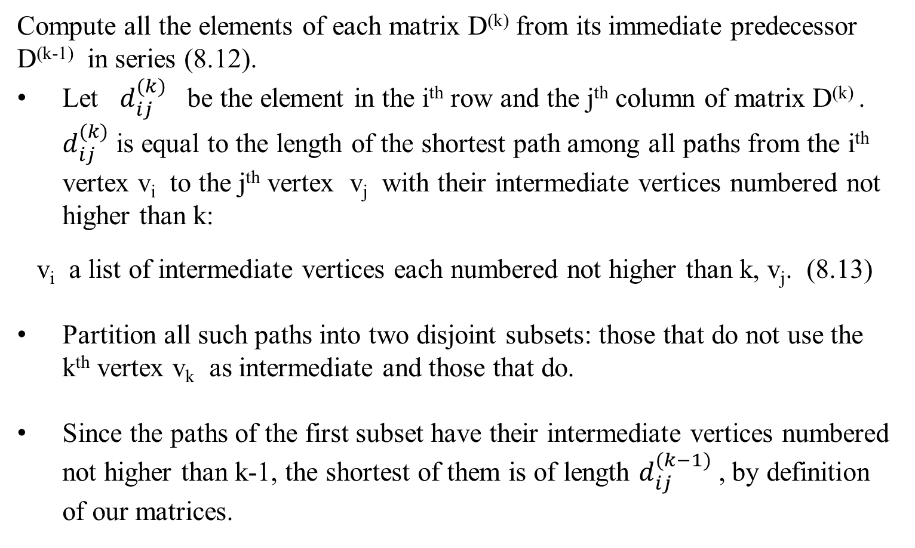
Floyd’s algorithm for generating the distance matrix.
Compute all the elements of each matrix D^{(k)} from its immediate predecessor D^{(k-1)} in series (8.12).
Let $d_{ij}^{(k)}$ be the element in the i^{th} row and the j^{th} column of matrix D^{(k)} . $d_{ij}^{(k)}$ is equal to the length of the shortest path among all paths from the i^{th} vertex v_{i} to the j^{th} vertex v_{j} with their intermediate vertices numbered not higher than k:
v_{i} a list of intermediate vertices each numbered not higher than k, v_{j}. (8.13)
Partition all such paths into two disjoint subsets: those that do not use the k^{th} vertex v_{k} as intermediate and those that do.
Since the paths of the first subset have their intermediate vertices numbered not higher than k-1, the shortest of them is of length $d_{ij}^{(k−1)}$ , by definition of our matrices.

Slide 7
What is the length of the shortest path in the second subset?
For the graph that does not contain a cycle of a negative length,
consider only to the paths in the second subset that use vertex v_{k} as their intermediate vertex exactly once
(because visiting v_{k} more than once can only increase the path’s length).
All such paths have the following form:
v_{i}, vertices numbered ≤ k -1, v_{k}, vertices numbered k -1, v_{j}.
That means, each of the paths is made up a path from v_{i} to v_{k} with each intermediate vertex numbered not higher than k-1 and a path from v_{k} to v_{j} with each intermediate vertex numbered not higher than k-1. The situation is as in Figure 8.15.

Slide 8


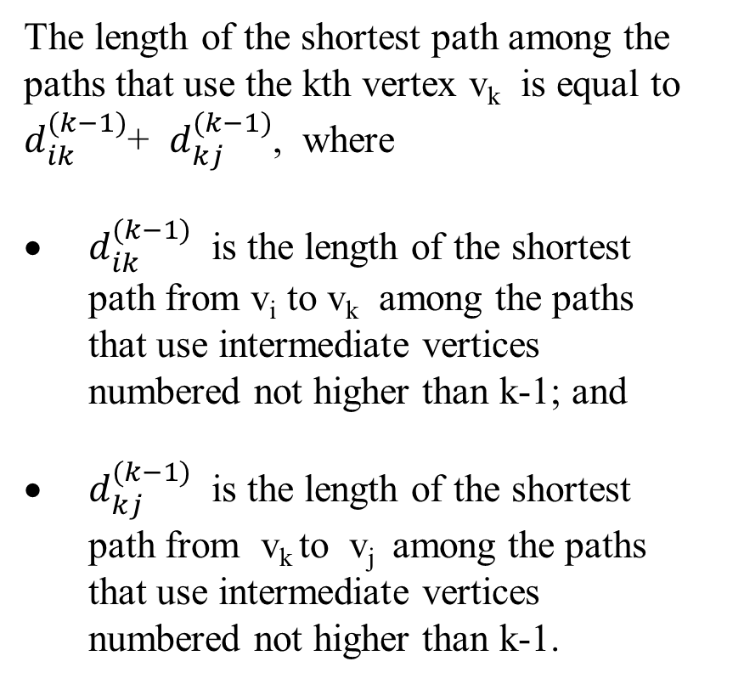
Floyd’s Algorithm
The length of the shortest path among the paths that use the kth vertex v_{k} is equal to $d_{ik}^{(k−1)}$+ $d_{kj}^{(k−1)}$, where
$d_{ik}^{(k−1)}$ is the length of the shortest path from v_{i} to v_{k} among the paths that use intermediate vertices numbered not higher than k-1; and
$d_{kj}^{(k−1)}$ is the length of the shortest path from v_{k} to v_{j} among the paths that use intermediate vertices numbered not higher than k-1.
$$d_{ij}^{\left(k−1\right)}$$
v_{i}
v_{j}
$d_{ik}^{(k−1)}$ $d_{kj}^{(k−1)}$
v_{k}
Figure 8.15 Underlying idea of
Floyd’s algorithm

Slide 9


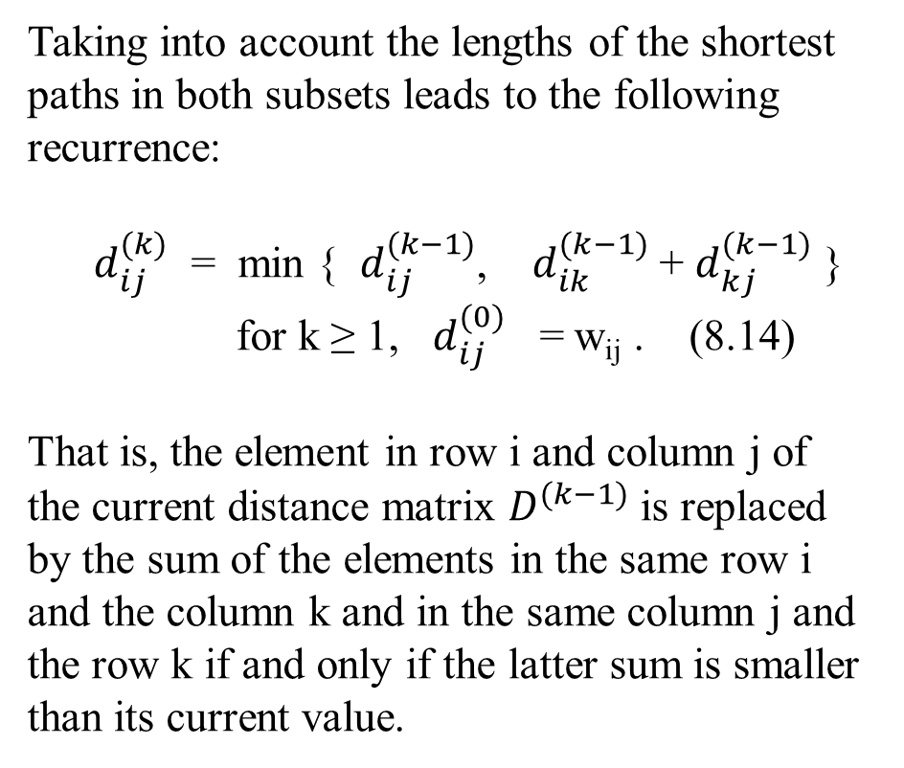
Floyd’s Algorithm
Taking into account the lengths of the shortest paths in both subsets leads to the following recurrence:
$d_{ij}^{(k)}$ = min { $d_{ij}^{(k−1)}$, $d_{ik}^{(k−1)}$ + $d_{kj}^{(k−1)}$ }
for k ≥ 1, $d_{ij}^{(0)}$ = w_{ij} . (8.14)
That is, the element in row i and column j of the current distance matrix $D^{(k−1)}$ is replaced by the sum of the elements in the same row i and the column k and in the same column j and the row k if and only if the latter sum is smaller than its current value.
$$d_{ij}^{\left(k−1\right)}$$
v_{i}
v_{j}
$d_{ik}^{(k−1)}$ $d_{kj}^{(k−1)}$
v_{k}
Figure 8.15 Underlying idea of
Floyd’s algorithm

Slide 10

Here is pseudocode of Floyd’s algorithm. It takes advantage of the fact that the next matrix in sequence (8.12) can be written over its predecessor.
Algorithm Floyd( W[ 1 .. n, 1 .. n ])
//implements Floyd’s algorithm for the all-pairs shortest-paths problem
Input: The weight matrix W of a graph with no negative-length cycle
Output: The distance matrix of the shortest paths’ lengths
D ← W //is not necessary if W can be overwritten
for k ← 1 to n do
for i ← 1 to n do
for j ← 1 to n do
D[i, j] ← min { D[i, j], D[i, k] + D[k, j] }
return D
Obviously, the time efficiency of Floyd’s algorithm is cubic, $θ\left(n^{3}\right)$– as is the time efficiency of Warshall’s algorithm.

Slide 11
a 1 b 2 c 3 d 4
a 1 0 ∞ 3 ∞
W = b 2 2 0 ∞ ∞
c 3 ∞ 7 0 1
d 4 6 ∞ ∞ 0
2
For D⁽¹⁾
e(a1, a1) = e(a1, a1) + e(a1, a1) = 0 + 0
e(a1, b2) = e(a1, a1) + e(a1, b2) = 0 + ∞
e(a1, c3) = e(a1, a1) + e(a1, c3) = 0 + 3
e(a1, d4) = e(a1, a1) + e(a1, d4) = 0 + ∞
e(b2, a1) = e(b2, a1) + e(a1, a1) = 2 + 0
e(b2, b2) = e(b2, a1) + e(a1, b2) = 2 + ∞
e(b2, c3) = e(b2, a1) + e(a1, c3) = 2 + 3
e(b2, d4) = e(b2, a1) + e(a1, d4) = 2 + ∞
e(c3, a1) = e(c3, a1) + e(a1, a1) = ∞ + 0
e(c3, b2) = e(c3, a1) + e(a1, b2) = ∞ + ∞
e(c3, c3) = e(c3, a1) + e(a1, c3) = ∞ +3
e(c3, d4) = e(c3, a1) + e(a1, d4) = ∞ + ∞
e(d4, a1) = e(d4, a1) + e(a1, a1) = 6 + 0
e(d4, b2) = e(d4, a1) + e(a1, b2) = 6 + ∞
e(d4, c3) = e(d4, a1) + e(a1, c3) = 6 + 3
e(d4, d4) = e(d4, a1) + e(a1, d4) = 6 + ∞
a
b
3 6 7
a1 b2 c3 d4
a1 0 ∞ 3 ∞
D⁽⁰⁾ = b2 2 0 ∞ ∞
c3 ∞ 7 0 1
d4 6 ∞ ∞ 0
c
d
1
a1 b2 c3 d4
a1 0 ∞ 3 ∞
D^{(1)’} = b2 2 ∞ 5 ∞
c3 ∞ ∞ ∞ ∞
d4 6 ∞ 9 ∞
a1 b2 c3 d4
a1 0 ∞ 3 ∞
D⁽¹⁾ = b2 2 0 5 ∞
c3 ∞ 7 0 1
d4 6 ∞ 9 0

Slide 12
a b c d
a 0 10 3 4
D = b 2 0 5 6
c 7 7 0 1
d 6 16 9 0
The application of Floyd’s algorithm to the graph in Figure 8.14 is illustrated in Figure 8.16.
a
2
b
(c) Its distance matrix
a b c d
a 0 ∞ 3 ∞
W = b 2 0 ∞ ∞
c ∞ 7 0 1
d 6 ∞ ∞ 0
3 6 7
c
d
1
Digraph
(b) Its weight matrix
Figure 8.14

Slide 13
Figure 8.16. The application of Floyd’s algorithm to the graph in Figure 8.14.
a1 b2 c3 d4
a1 0 ∞ 3 ∞
D⁽⁰⁾ = b2 2 0 ∞ ∞
c3 ∞ 7 0 1
d4 6 ∞ ∞ 0
Lengths of the shortest paths
with no intermediate vertices
(D⁽⁰⁾ is simply the weight matrix).
a
2
b
(b) Its weight matrix
3 6 7
c
d
When k =1. Applying D[i, j] ← min { D[i, j], D[i, k] + D[k, j] }
D⁽¹⁾ [i=1, j=1] = min{ D⁽⁰⁾[1, 1], D⁽⁰⁾[1, 1] + D⁽⁰⁾[1, 1]}= min{0, 0} = 0
D⁽¹⁾ [i=1, j=2] = min{ D⁽⁰⁾[1, 2], D⁽⁰⁾[1, 1] + D⁽⁰⁾[1, 2]}= min{∞, ∞} = ∞
D⁽¹⁾ [i=1, j=3] = min{ D⁽⁰⁾[1, 3], D⁽⁰⁾[1, 1] + D⁽⁰⁾[1, 3]}= min{3, 3} = 3
D⁽¹⁾ [i=1, j=4] = min{ D⁽⁰⁾[1, 4], D⁽⁰⁾[1, 1] + D⁽⁰⁾[1, 4]}= min{∞, ∞} = ∞
1

Slide 14
a1 b2 c3 d4
a1 0 ∞ 3 ∞
D⁽⁰⁾ = b2 2 0 5 ∞ ∞
c3 ∞ 7 0 1
d4 6 ∞ ∞ 0
Lengths of the shortest paths
with no intermediate vertices
(D⁽⁰⁾ is simply the weight matrix).
a
2
b
(b) Its weight matrix
3 6 7
When k =1. Applying D[i, j] ← min { D[i, j], D[i, k] + D[k, j] }
…
D⁽¹⁾ [i=2, j=1] = min{ D⁽⁰⁾[2, 1], D⁽⁰⁾[2, 1] + D⁽⁰⁾[1, 1]}= min{2, 2} = 2
D⁽¹⁾ [i=2, j=2] = min{ D⁽⁰⁾[2, 2], D⁽⁰⁾[2, 1] + D⁽⁰⁾[1, 2]}= min{0, ∞ 2} = 0
D⁽¹⁾ [i=2, j=3] = min{ D⁽⁰⁾[2, 3], D⁽⁰⁾[2, 1] + D⁽⁰⁾[1, 3]}= min{∞, 5} = 5
D⁽¹⁾ [i=2, j=4] = min{ D⁽⁰⁾[2, 4], D⁽⁰⁾[2, 1] + D⁽⁰⁾[1, 4]}= min{∞, ∞} = ∞
c
d
1
(bac)

Slide 15
a1 b2 c3 d4
a1 0 ∞ 3 ∞
D⁽⁰⁾ = b2 2 0 5 ∞ ∞
c3 ∞ 7 0 1
d5 6 ∞ ∞ 0
Lengths of the shortest paths
with no intermediate vertices
(D⁽⁰⁾ is simply the weight matrix).
a
2
b
(b) Its weight matrix
3 6 7
When k =1. Applying D[i, j] ← min { D[i, j], D[i, k] + D[k, j] }
…
D⁽¹⁾ [i=3, j=1] = min{ D⁽⁰⁾[3, 1], D⁽⁰⁾[3, 1] + D⁽⁰⁾[1, 1]}= min{∞, ∞} = ∞
D⁽¹⁾ [i=3, j=2] = min{ D⁽⁰⁾[3, 2], D⁽⁰⁾[3, 1] + D⁽⁰⁾[1, 2]}= min{7, ∞} = 7
D⁽¹⁾ [i=3, j=3] = min{ D⁽⁰⁾[3, 3], D⁽⁰⁾[3, 1] + D⁽⁰⁾[1, 3]}= min{0, ∞} = 0
D⁽¹⁾ [i=3, j=4] = min{ D⁽⁰⁾[3, 4], D⁽⁰⁾[3, 1] + D⁽⁰⁾[1, 4]}= min{1, ∞} = 1
c
d
1

Slide 16
a1 b2 c3 d4
a1 0 ∞ 3 ∞
D⁽⁰⁾ = b2 2 0 5 ∞ ∞
c3 ∞ 7 0 1
d4 6 ∞ 9 ∞ 0
Lengths of the shortest paths
with no intermediate vertices
(D⁽⁰⁾ is simply the weight matrix).
a
2
b
(b) Its weight matrix
3 6 7
When k =1. Applying D[i, j] ← min { D[i, j], D[i, k] + D[k, j] }
…
D⁽¹⁾ [i=4, j=1] = min{ D⁽⁰⁾[4, 1], D⁽⁰⁾[4, 1] + D⁽⁰⁾[1, 1]}= min{6, 6} = 6
D⁽¹⁾ [i=4, j=2] = min{ D⁽⁰⁾[4, 2], D⁽⁰⁾[4, 1] + D⁽⁰⁾[1, 2]}= min{∞, ∞} = ∞
D⁽¹⁾ [i=4, j=3] = min{ D⁽⁰⁾[4, 3], D⁽⁰⁾[4, 1] + D⁽⁰⁾[1, 3]}= min{∞, 9} = 9
D⁽¹⁾ [i=4, j=4] = min{ D⁽⁰⁾[4, 4], D⁽⁰⁾[4, 1] + D⁽⁰⁾[1, 4]}= min{0, ∞} = 0
c
d
1
(dac)
This yields the following D⁽¹⁾

Slide 17
a1 b2 c3 d4
a1 0 ∞ 3 ∞
D⁽¹⁾ = b2 2 0 5 ∞
c3 ∞ 7 0 1
d4 6 ∞ 9 0
Lengths of the shortest paths
with intermediate vertices numbered not higher than 1, i.e., just a (note two new shortest paths from b to c and from d to c)
a
2
b
(b) Its weight matrix
3 6 7
c
d
When k =2. Applying D[i, j] ← min { D[i, j], D[i, k] + D[k, j] }
D⁽²⁾ [i=1, j=1] = min{ D⁽¹⁾[1, 1], D⁽¹⁾[1, 2] + D⁽¹⁾[2, 1]}= min{0, ∞} = 0
D⁽²⁾ [i=1, j=2] = min{ D⁽¹⁾[1, 2], D⁽¹⁾[1, 2] + D⁽¹⁾[2, 2]}= min{∞, ∞} = ∞
D⁽²⁾ [i=1, j=3] = min{ D⁽¹⁾[1, 3], D⁽¹⁾[1, 2] + D⁽¹⁾[2, 3]}= min{3, ∞} = 3
D⁽²⁾ [i=1, j=4] = min{ D⁽¹⁾[1, 4], D⁽¹⁾[1, 2] + D⁽¹⁾[2, 4]}= min{∞, ∞} = ∞
1

Slide 18
a1 b2 c3 d4
a1 0 ∞ 3 ∞
D⁽¹⁾ = b2 2 0 5 ∞
c3 ∞ 7 0 1
d4 6 ∞ 9 0
Lengths of the shortest paths
with intermediate vertices numbered not higher than 1, i.e., just a (note two new shortest paths from b to c and from d to c)
a
2
b
(b) Its weight matrix
3 6 7
When k =2. Applying D[i, j] ← min { D[i, j], D[i, k] + D[k, j] }
…
D⁽²⁾ [i=2, j=1] = min{ D⁽¹⁾[2, 1], D⁽¹⁾[2, 2] + D⁽¹⁾[2, 1]}= min{2, 2} = 2
D⁽²⁾ [i=2, j=2] = min{ D⁽¹⁾[2, 2], D⁽¹⁾[2, 2] + D⁽¹⁾[2, 2]}= min{0, 0} = 0
D⁽²⁾ [i=2, j=3] = min{ D⁽¹⁾[2, 3], D⁽¹⁾[2, 2] + D⁽¹⁾[2, 3]}= min{5, 5} = 5
D⁽²⁾ [i=2, j=4] = min{ D⁽¹⁾[2, 4], D⁽¹⁾[2, 2] + D⁽¹⁾[2, 4]}= min{∞, ∞} = ∞
c
d
1

Slide 19
a1 b2 c3 d4
a1 0 ∞ 3 ∞
D⁽¹⁾ = b2 2 0 5 ∞
c3 ∞ 7 0 1
d4 6 ∞ 9 0
Lengths of the shortest paths
with intermediate vertices numbered not higher than 1, i.e., just a (note two new shortest paths from b to c and from d to c)
(b) Its weight matrix
a
2
b
When k =2. Applying D[i, j] ← min { D[i, j], D[i, k] + D[k, j] }
…
D⁽²⁾ [i=3, j=1] = min{ D⁽¹⁾[3, 1], D⁽¹⁾[3, 2] + D⁽¹⁾[2, 1]}= min{∞, 9} = 9
D⁽²⁾ [i=3, j=2] = min{ D⁽¹⁾[3, 2], D⁽¹⁾[3, 2] + D⁽¹⁾[2, 2]}= min{7, 7} = 7
D⁽²⁾ [i=3, j=3] = min{ D⁽¹⁾[3, 3], D⁽¹⁾[3, 2] + D⁽¹⁾[2, 3]}= min{0, 5} = 0
D⁽²⁾ [i=3, j=4] = min{ D⁽¹⁾[3, 4], D⁽¹⁾[3, 2] + D⁽¹⁾[2, 4]}= min{1, ∞} = 1
3 6 7
(cba)
c
d
1

Slide 20
a1 b2 c3 d4
a1 0 ∞ 3 ∞
D⁽¹⁾ = b2 2 0 5 ∞
c3 9 ∞ 7 0 1
d4 6 ∞ 9 0
Lengths of the shortest paths
with intermediate vertices numbered not higher than 1, i.e., just a (note two new shortest paths from b to c and from d to c)
a
2
b
(b) Its weight matrix
3 6 7
When k =2. Applying D[i, j] ← min { D[i, j], D[i, k] + D[k, j] }
…
D⁽²⁾ [i=4, j=1] = min{ D⁽¹⁾[4, 1], D⁽¹⁾[4, 2] + D⁽¹⁾[2, 1]}= min{6, ∞} = 6
D⁽²⁾ [i=4, j=2] = min{ D⁽¹⁾[4, 2], D⁽¹⁾[4, 2] + D⁽¹⁾[2, 2]}= min{∞, ∞} = ∞
D⁽²⁾ [i=4, j=3] = min{ D⁽¹⁾[4, 3], D⁽¹⁾[4, 2] + D⁽¹⁾[2, 3]}= min{9, ∞} = 9
D⁽²⁾ [i=4, j=4] = min{ D⁽¹⁾[4, 4], D⁽¹⁾[4, 2] + D⁽¹⁾[2, 4]}= min{0, ∞} = 0
This yields the following D⁽²⁾
c
d
1

Slide 21
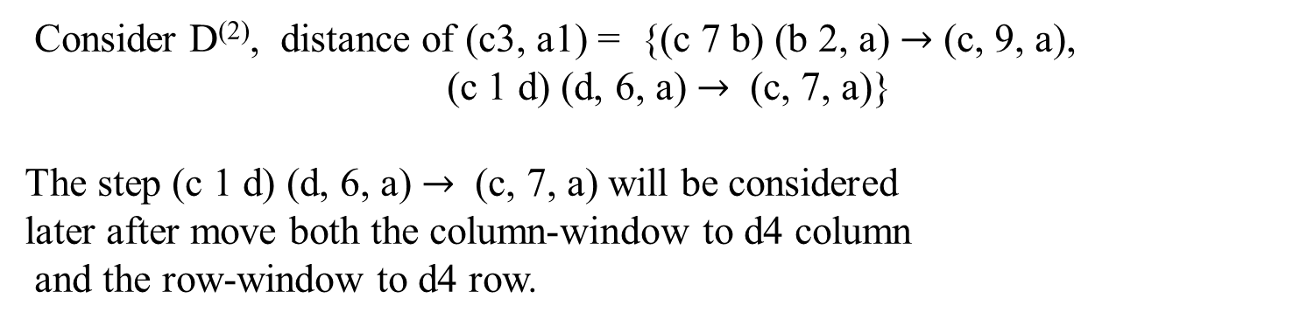
a1 b2 c3 d4
a1 0 10∞ 3 ∞
D⁽²⁾ = b2 2 0 5 ∞
c3 9 7 0 1
d4 6 ∞ 9 0
Lengths of the shortest paths
with intermediate vertices numbered not higher than 2, i.e., a and b (note a new shortest paths c to a).
(b) Its weight matrix
Consider D⁽²⁾, distance of (c3, a1) = {(c 7 b) (b 2, a) $→$ (c, 9, a),
(c 1 d) (d, 6, a) $→$ (c, 7, a)}
The step (c 1 d) (d, 6, a) $→$ (c, 7, a) will be considered
later after move both the column-window to d4 column
and the row-window to d4 row.
a
2
b
3 6 7
c
d
1

Slide 22
a1 b2 c3 d4
a1 0 10∞ 3 ∞
D⁽²⁾ = b2 2 0 5 ∞
c3 9 7 0 1
d4 6 ∞ 9 0
Lengths of the shortest paths
with intermediate vertices numbered not higher than 2, i.e., a and b (note a new shortest paths c to a).
(b) Its weight matrix
When k =3. Applying D[i, j] ← min { D[i, j], D[i, k] + D[k, j] }
….
a
2
b
3 6 7
c
d
1

Slide 23
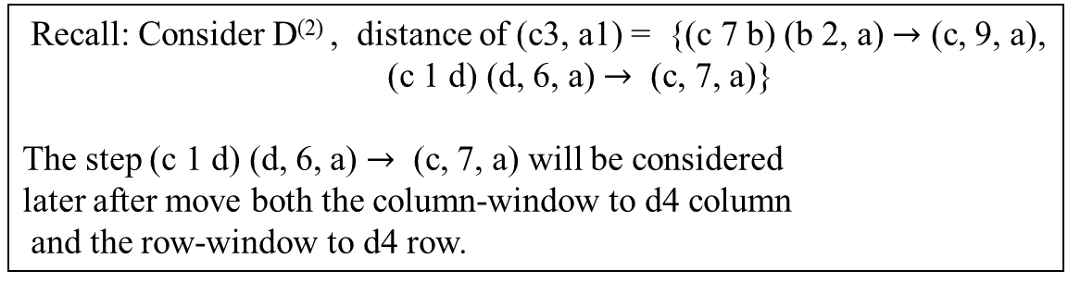
a1 b2 c3 d4
a1 0 10 3 4
D⁽³⁾ = b2 2 0 5 6
c3 9 7 0 1
d4 6 16 9 0
Lengths of the shortest paths
with intermediate vertices numbered not higher than 3, i.e., a, b and c (note four new shortest paths from a to d, from b to d, and from d to b).
(b) Its weight matrix
When k =4. Applying D[i, j] ← min { D[i, j], D[i, k] + D[k, j] }
….
a
2
b
D⁽⁴⁾ [i=3, j=1] = min{ D⁽³⁾[3, 1], D⁽³⁾[3, 4] + D⁽³⁾[4, 1]}= min{9, 7} = 7
Recall: Consider D⁽²⁾ , distance of (c3, a1) = {(c 7 b) (b 2, a) $→$ (c, 9, a),
(c 1 d) (d, 6, a) $→$ (c, 7, a)}
The step (c 1 d) (d, 6, a) $→$ (c, 7, a) will be considered
later after move both the column-window to d4 column
and the row-window to d4 row.
3 6 7
c
d
1

Slide 24
a1 b2 c3 d4
a1 0 10 3 4
D⁽⁴⁾ = b2 2 0 5 6
c3 7 7 0 1
d4 6 16 9 0
Lengths of the shortest paths
with intermediate vertices numbered not higher than 4, i.e., a, b, c and d (note a new shortest paths from c to a).
(b) Its weight matrix
Figure 8.16 Application of Floyd’s algorithm to the diagraph shown. Updated elements are shown in bold.
2
b
a
3 6 7
When k =5. End….
Digraph
c
d
1

Slide 25
Here is pseudocode of Floyd’s algorithm. It takes advantage of the fact that the next matrix in sequence (8.12) can be written over its predecessor.
Algorithm Floyd( W[ 1 .. n, 1 .. n ])
//implements Floyd’s algorithm for the all-pairs shortest-paths problem
Input: The weight matrix W of a graph with no negative-length cycle
Output: The distance matrix of the shortest paths’ lengths
D ← W //is not necessary if W can be overwritten
for k ← 1 to n do
for i ← 1 to n do
for j ← 1 to n do
D[i, j] ← min { D[i, j], D[i, k] + D[k, j] }
return D
Obviously, the time efficiency of Floyd’s algorithm is cubic, $θ\left(n^{3}\right)$– as is the time efficiency of Warshall’s algorithm.

Slide 26
Time Complexity of Floyd’s Algorithm for all-pairs shortest-paths
Basic operation: The instruction in the for-j loop.
Input size: n, the number of vertices in the graph.
Analysis: There is the most inner for-j loop within the for-i loop within the most outer for-k loop, with n passes through each loop. Thus,
T(n) = n * n * n
= n³
= ϴ(n³)

Slide 27
Chapter 06_05
Dynamic Programming
Optimal Binary Search Trees

